Slide 1
Computer vision: models, learning and inference
Chapter 6
Learning and Inference in Vision

Slide 2
Structure
Computer vision models
Two types of model
Worked example 1: Regression
Worked example 2: Classification
Which type should we choose?
Applications
Computer vision: models, learning and inference. ©2011 Simon J.D. Prince
2

Slide 3
Computer vision models
Observe measured data, x
Draw inferences from it about state of world, w
Examples:
Observe adjacent frames in video sequence
Infer camera motion
Observe image of face
Infer identity
Observe images from two displaced cameras
Infer 3d structure of scene

Slide 4
Regression vs. Classification
Observe measured data, x
Draw inferences from it about world, w
When the world state w is continuous we’ll call this regression
When the world state w is discrete we call this classification

Slide 5
Ambiguity of visual world
Unfortunately visual measurements may be compatible with more than one world state w
Measurement process is noisy
Inherent ambiguity in visual data
Conclusion: the best we can do is compute a probability distribution Pr(w|x) over possible states of world

Slide 6
Refined goal of computer vision
Take observations x
Return probability distribution Pr(w|x) over possible worlds compatible with data
(not always tractable – might have to settle for an approximation to this distribution, samples from it, or the best (MAP) solution for w)

Slide 7
Components of solution
We need
A model that mathematically relates the visual data x to the world state w. Model specifies family of relationships, particular relationship depends on parameters θ
A learning algorithm: fits parameters θ from paired training examples x_{i},w_{i}
An inference algorithm: uses model to return Pr(w|x) given new observed data x.

Slide 8
Types of Model
The model mathematically relates the visual data x to the world state w. Two main categories of model
Model contingency of the world on the data Pr(w|x)
Model contingency of data on world Pr(x|w)

Slide 9
Generative vs. Discriminative
Model contingency of the world on the data Pr(w|x)
(DISCRIMINATIVE MODEL)
2. Model contingency of data on world Pr(x|w)
(GENERATIVE MODELS)
Generative as probability model over data and so when we draw samples from model, we GENERATE new data

Slide 10
Type 1: Model Pr(w|x) - Discriminative
How to model Pr(w|x)?
Choose an appropriate form for Pr(w)
Make parameters a function of x
Function takes parameters θ that define its shape
Learning algorithm: learn parameters θ from training data x,w
Inference algorithm: just evaluate Pr(w|x)

Slide 11
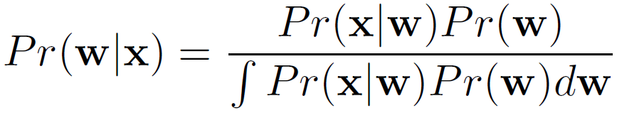
Type 2: Pr(x|w) - Generative
How to model Pr(x|w)?
Choose an appropriate form for Pr(x)
Make parameters a function of w
Function takes parameters θ that define its shape
Learning algorithm: learn parameters θ from training data x,w
Inference algorithm: Define prior Pr(w) and then compute Pr(w|x) using Bayes’ rule

Slide 12
Summary
Two ifferent types of model depend on the quantity of interest:
Pr(w|x) Discriminative
Pr(w|x) Generative
Inference in discriminative models easy as we directly model posterior Pr(w|x). Generative models require more complex inference process using Bayes’ rule

Slide 13
Structure
Computer vision models
Two types of model
Worked example 1: Regression
Worked example 2: Classification
Which type should we choose?
Applications
Computer vision: models, learning and inference. ©2011 Simon J.D. Prince
13

Slide 14
Worked example 1: Regression
Consider simple case where
we make a univariate continuous measurement x
use this to predict a univariate continuous state w
(regression as world state is continuous)

Slide 15
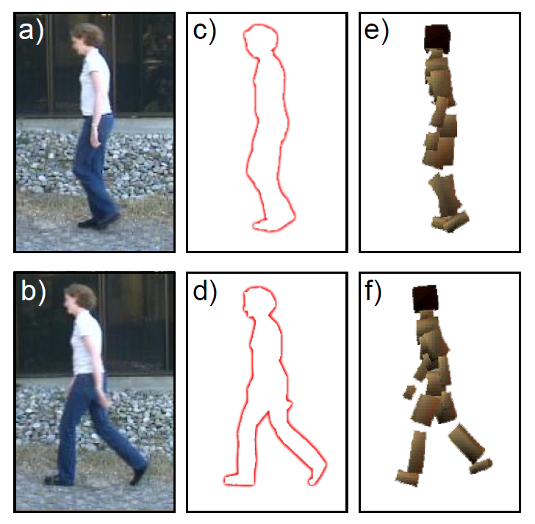
Regression application 1: Pose from Silhouette

Slide 16
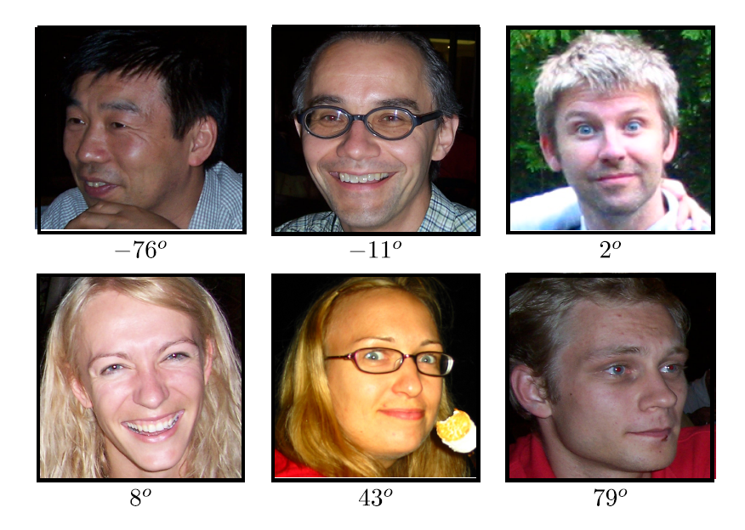
Regression application 2: Head pose estimation

Slide 17
Worked example 1: Regression
Consider simple case where
we make a univariate continuous measurement x
use this to predict a univariate continuous state w
(regression as world state is continuous)

Slide 18
Type 1: Model Pr(w|x) - Discriminative
How to model Pr(w|x)?
Choose an appropriate form for Pr(w)
Make parameters a function of x
Function takes parameters θ that define its shape
Learning algorithm: learn parameters θ from training data x,w
Inference algorithm: just evaluate Pr(w|x)

Slide 19
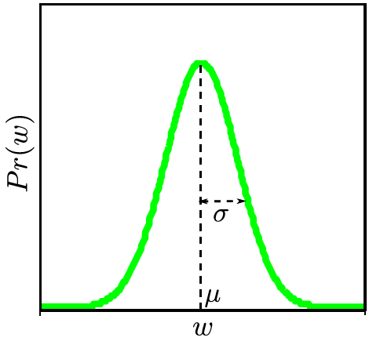
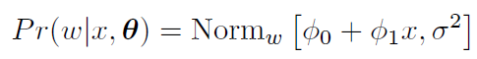
Type 1: Model Pr(w|x) - Discriminative
How to model Pr(w|x)?
Choose an appropriate form for Pr(w)
Make parameters a function of x
Function takes parameters θ that define its shape
Choose normal distribution over w
Make mean μ linear function of x (variance constant)
Parameters are φ₀, φ₁, σ².
This model is called linear regression.

Slide 20
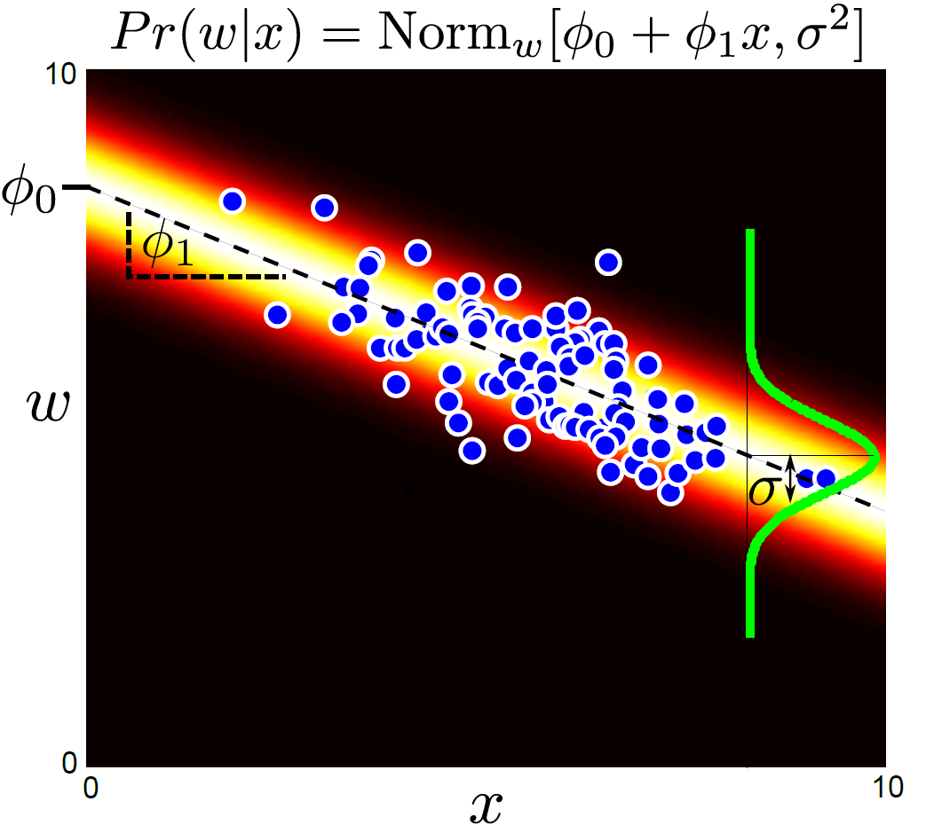
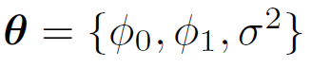
Parameters are y-offset, slope and variance

Slide 21
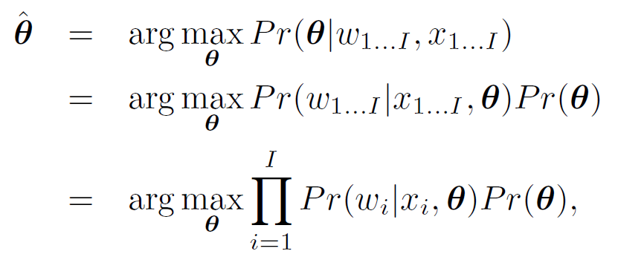
Learning algorithm: learn θ from training data x,y. E.g. MAP

Slide 22
Inference algorithm: just evaluate Pr(w|x) for new data x

Slide 23
Type 2: Pr(x|w) - Generative
How to model Pr(x|w)?
Choose an appropriate form for Pr(x)
Make parameters a function of w
Function takes parameters θ that define its shape
Learning algorithm: learn parameters θ from training data x,w
Inference algorithm: Define prior Pr(w) and then compute Pr(w|x) using Bayes’ rule

Slide 24
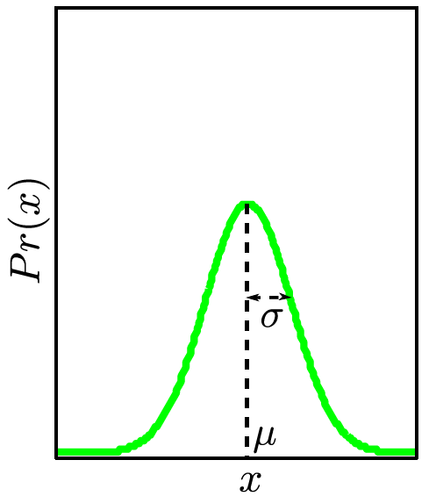
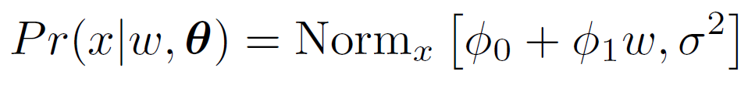
Type 2: Pr(x|w) - Generative
How to model Pr(x|w)?
Choose an appropriate form for Pr(x)
Make parameters a function of w
Function takes parameters θ that define its shape
Choose normal distribution over x
Make mean μ linear function of w (variance constant)
Parameter are φ₀, φ₁, σ².

Slide 25
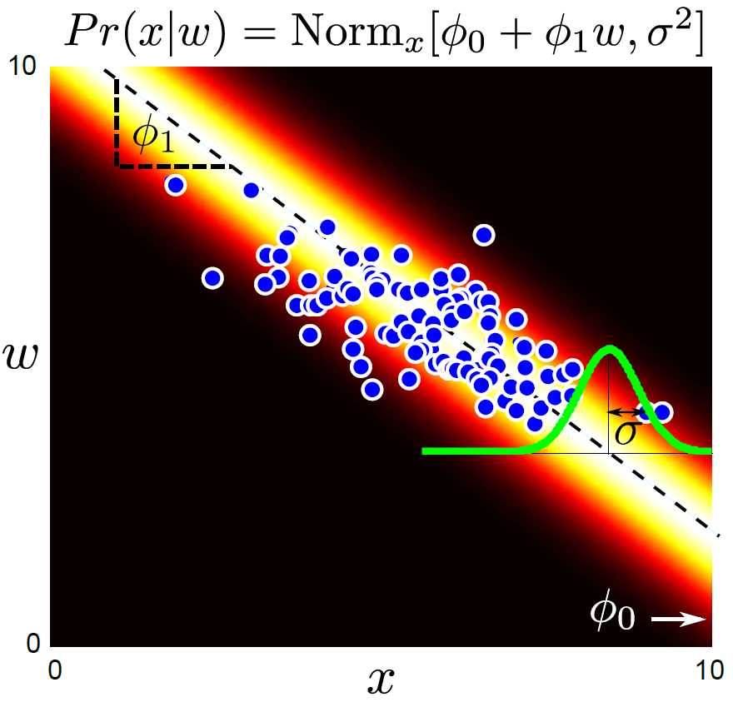
Learning algorithm: learn θ from training data x,w. e.g. MAP

Slide 26
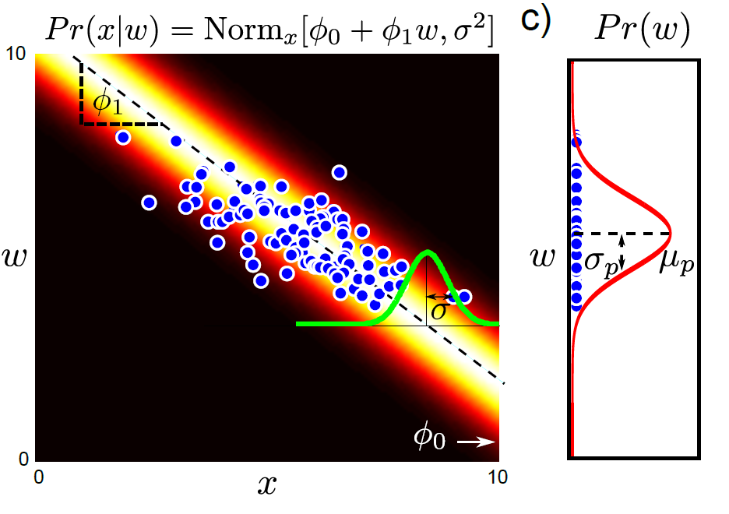
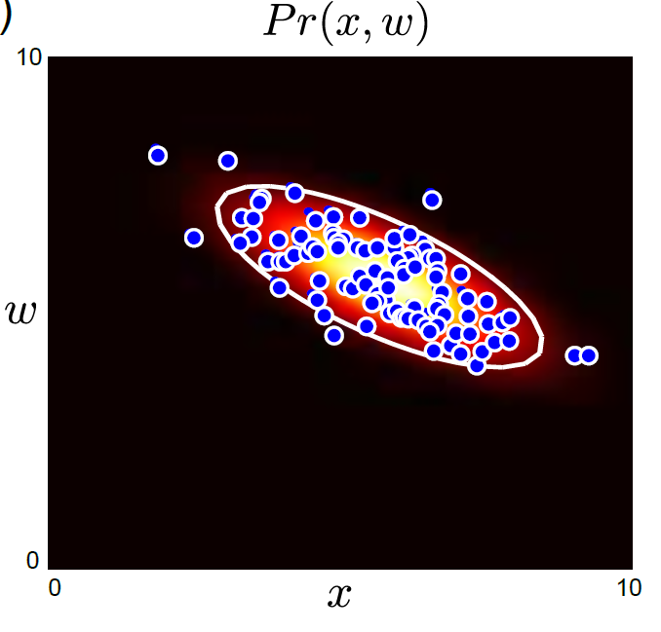
Pr(x|w) x Pr(w) = Pr(x,w)
Can get back to joint probability Pr(x,y)

Slide 27
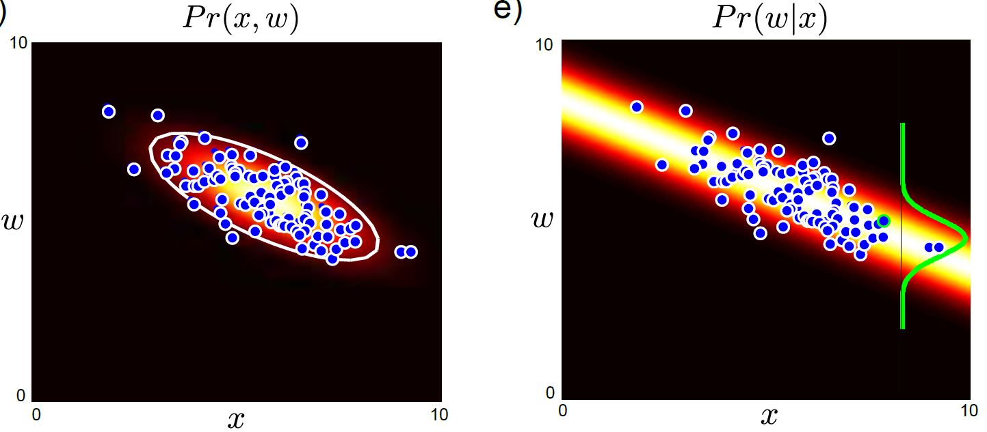
Inference algorithm: compute Pr(w|x) using Bayes rule

Slide 28
Structure
Computer vision models
Three types of model
Worked example 1: Regression
Worked example 2: Classification
Which type should we choose?
Applications
Computer vision: models, learning and inference. ©2011 Simon J.D. Prince
28

Slide 29
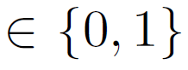
Worked example 2: Classification
Consider simple case where
we make a univariate continuous measurement x
use this to predict a discrete binary world
w
(classification as world state is discrete)

Slide 30
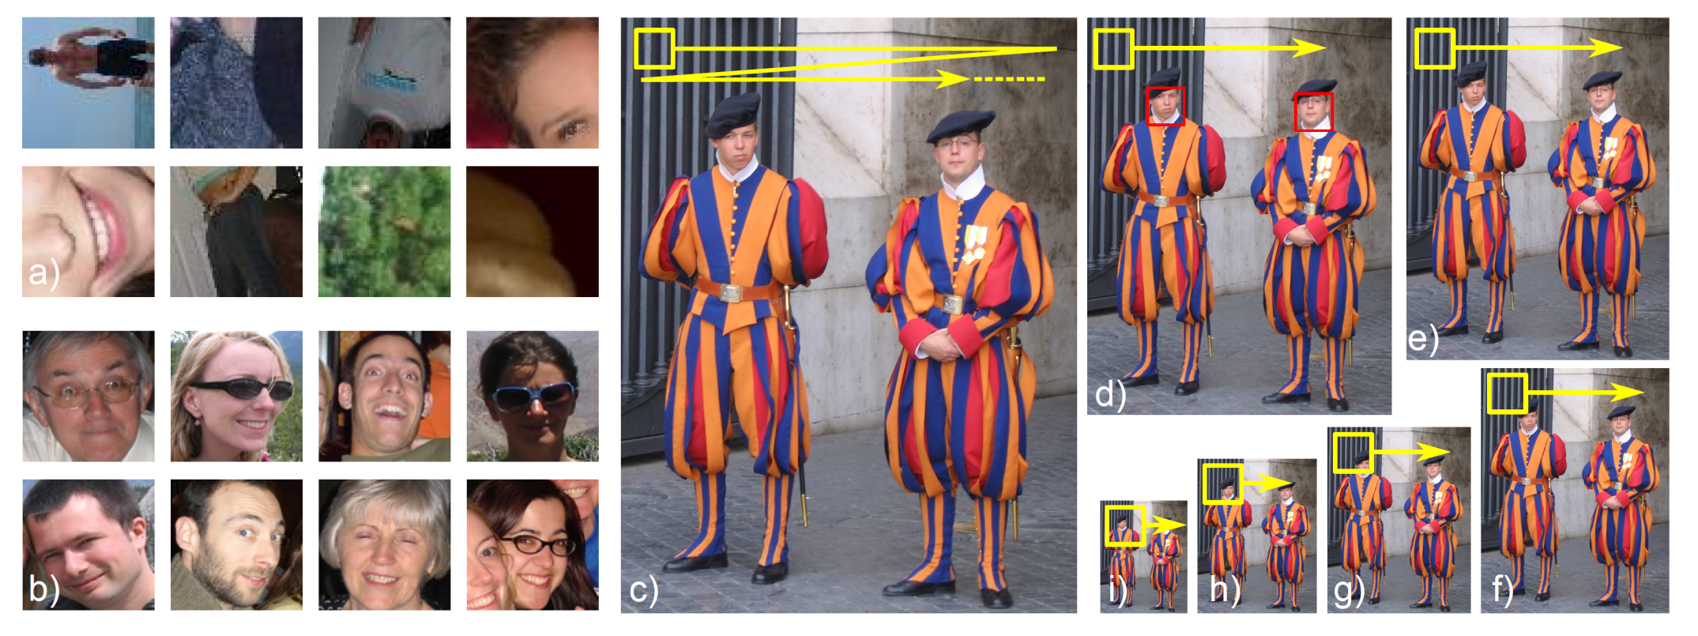
Classification Example 1: Face Detection

Slide 31
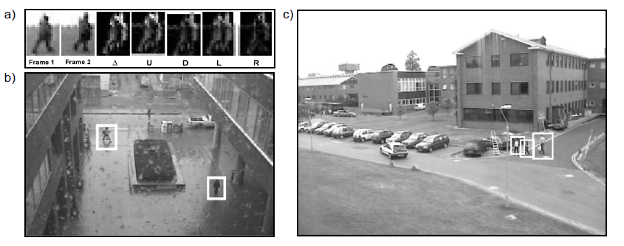
Classification Example 2: Pedestrian Detection

Slide 32
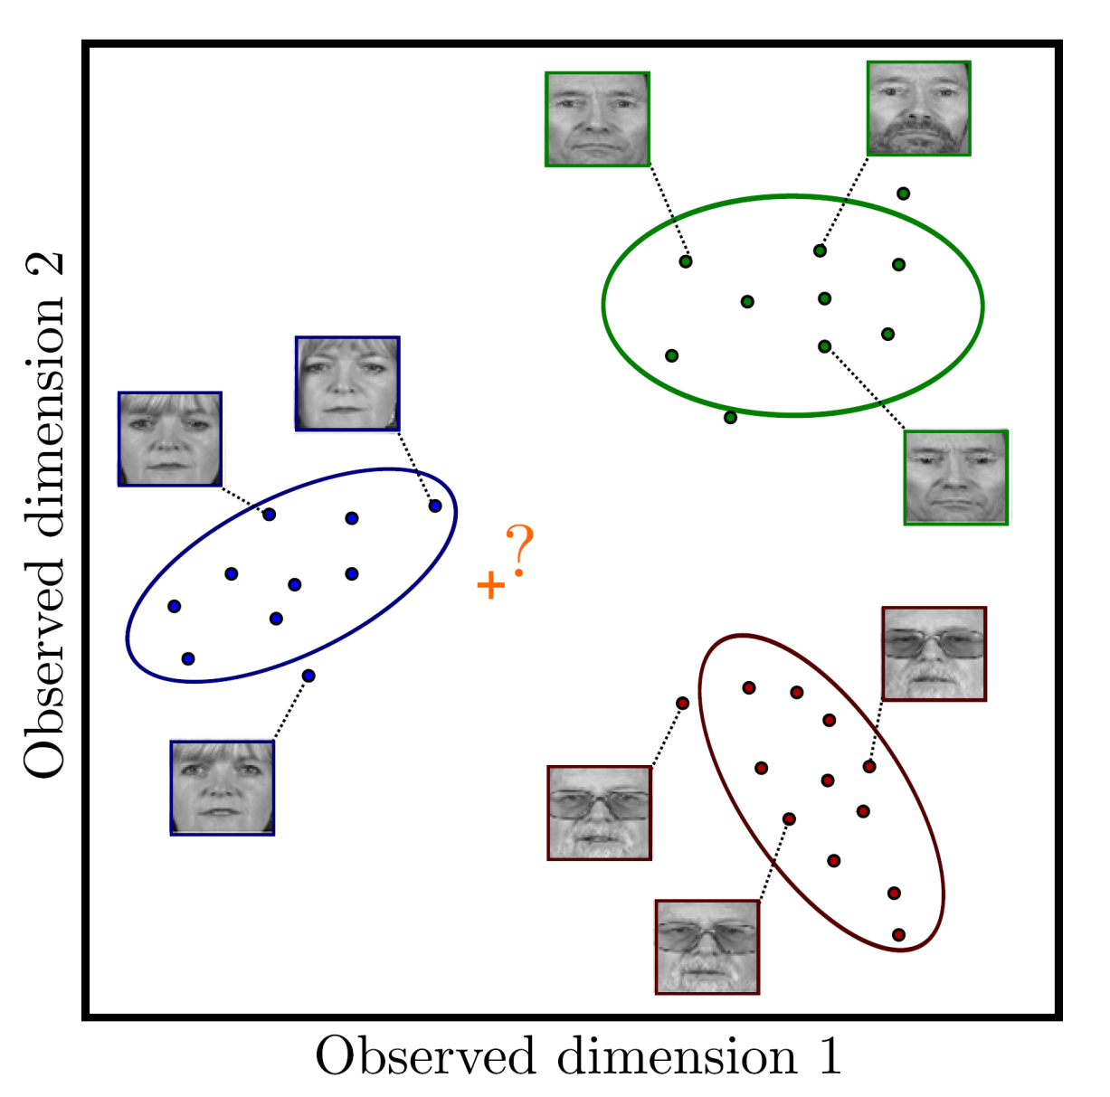
Classification Example 3: Face Recognition

Slide 33
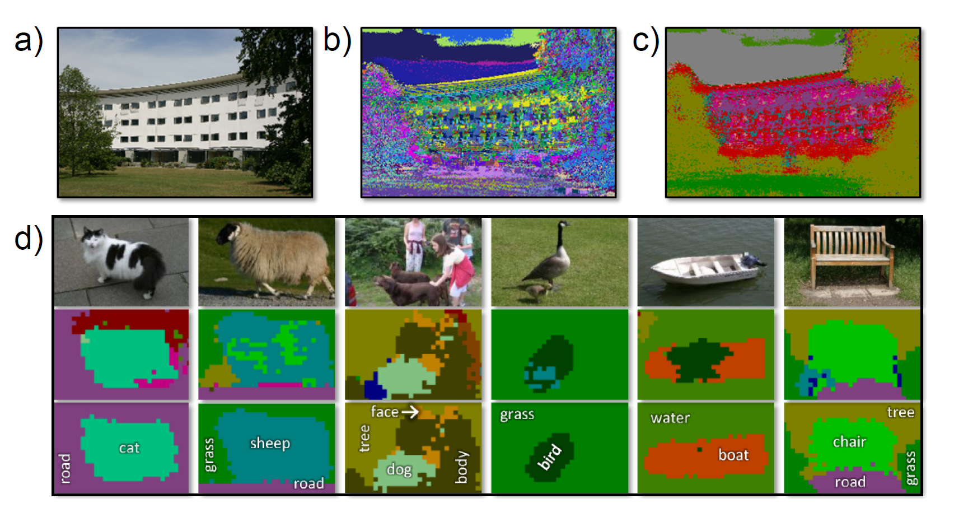
Classification Example 4: Semantic Segmentation

Slide 34
Worked example 2: Classification
Consider simple case where
we make a univariate continuous measurement x
use this to predict a discrete binary world
w
(classification as world state is discrete)

Slide 35
Type 1: Model Pr(w|x) - Discriminative
How to model Pr(w|x)?
Choose an appropriate form for Pr(w)
Make parameters a function of x
Function takes parameters θ that define its shape
Learning algorithm: learn parameters θ from training data x,w
Inference algorithm: just evaluate Pr(w|x)

Slide 36
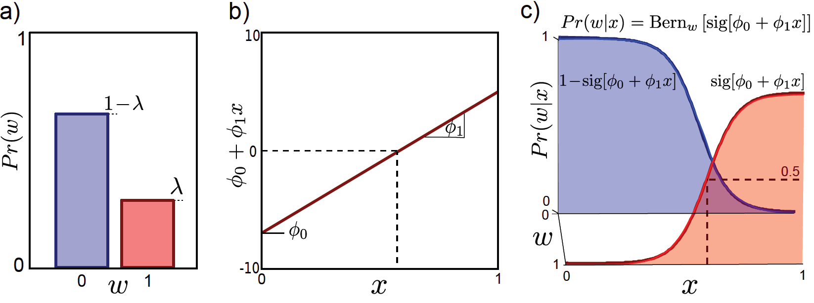
Type 1: Model Pr(w|x) - Discriminative
How to model Pr(w|x)?
Choose an appropriate form for Pr(w)
Make parameters a function of x
Function takes parameters θ that define its shape
Choose Bernoulli dist. for Pr(w)
Make parameters a function of x
Function takes parameters φ₀ and φ₁
This model is called logistic regression.

Slide 37
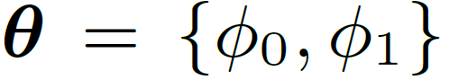
Two parameters
Learning by standard methods (ML,MAP, Bayesian)
Inference: Just evaluate Pr(w|x)

Slide 38
Type 2: Pr(x|w) - Generative
How to model Pr(x|w)?
Choose an appropriate form for Pr(x)
Make parameters a function of w
Function takes parameters θ that define its shape
Learning algorithm: learn parameters θ from training data x,w
Inference algorithm: Define prior Pr(w) and then compute Pr(w|x) using Bayes’ rule

Slide 39
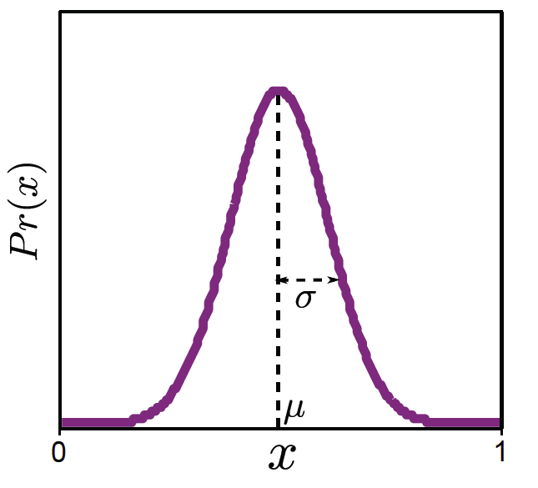
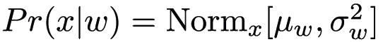
Type 2: Pr(x|w) - Generative
How to model Pr(x|w)?
Choose an appropriate form for Pr(x)
Make parameters a function of w
Function takes parameters θ that define its shape
Choose a Gaussian distribution for Pr(x)
Make parameters a function of discrete binary w
3. Function takes parameters μ₀, μ₁, σ²₀, σ²₁ that define its shape

Slide 40
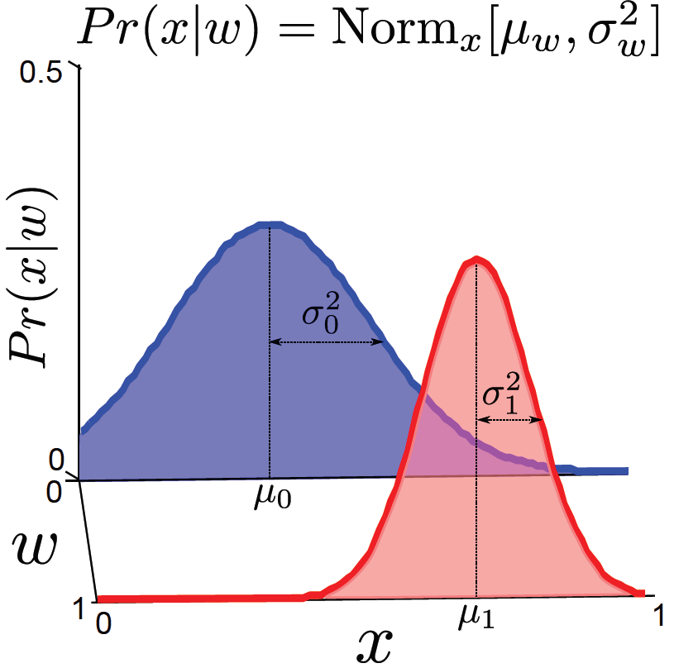
Learn parameters μ₀, μ₁, σ²₀, σ²₁ that define its shape

Slide 41
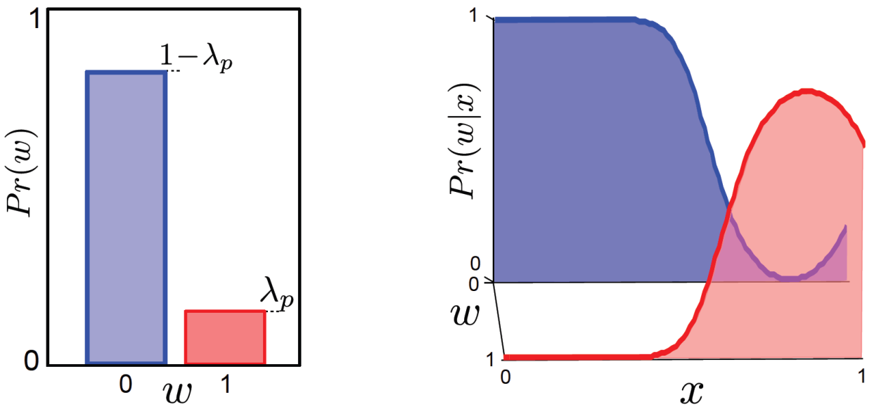

Inference algorithm: Define prior Pr(w) and then compute Pr(w|x) using Bayes’ rule

Slide 42
Structure
Computer vision models
Three types of model
Worked example 1: Regression
Worked example 2: Classification
Which type should we choose?
Applications
Computer vision: models, learning and inference. ©2011 Simon J.D. Prince
42

Slide 43
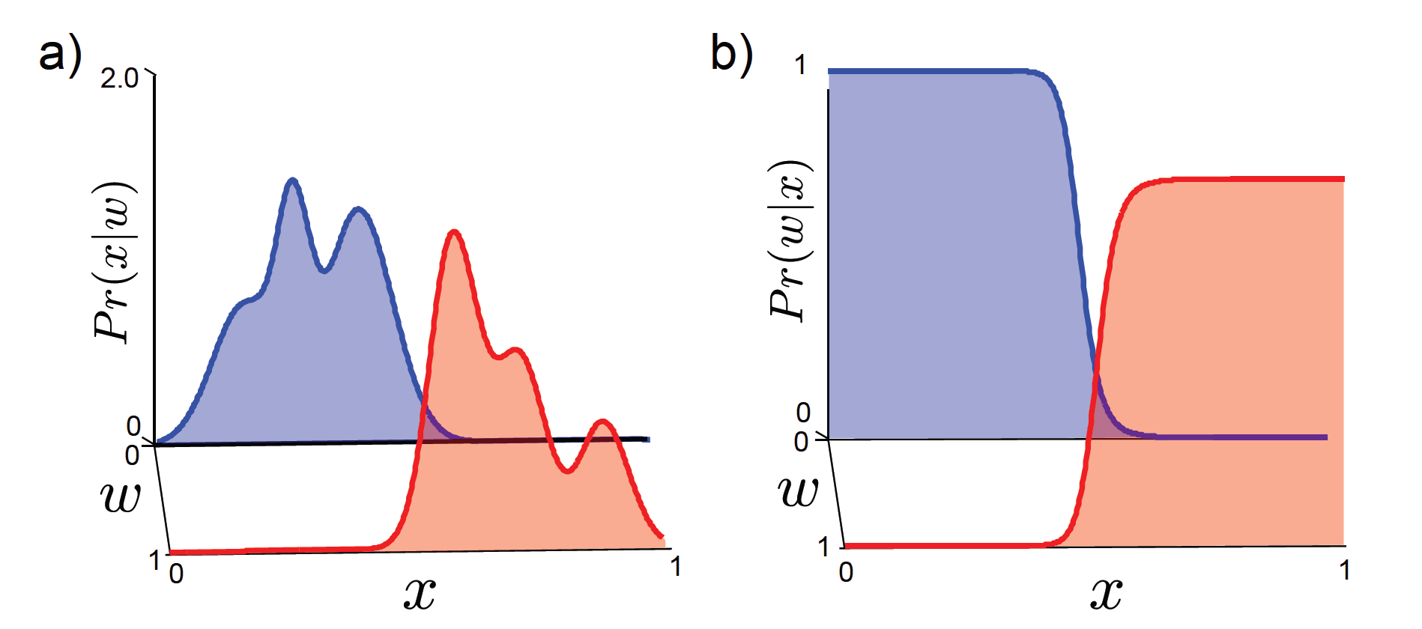
Which type of model to use?
Generative methods model data – costly and many aspects of data may have no influence on world state

Slide 44
Which type of model to use?
Inference simple in discriminative models
Data really is generated from world – generative matches this
If missing data, then generative preferred
Generative allows imposition of prior knowledge specified by user

Slide 45
Structure
Computer vision models
Three types of model
Worked example 1: Regression
Worked example 2: Classification
Which type should we choose?
Applications
Computer vision: models, learning and inference. ©2011 Simon J.D. Prince
45

Slide 46
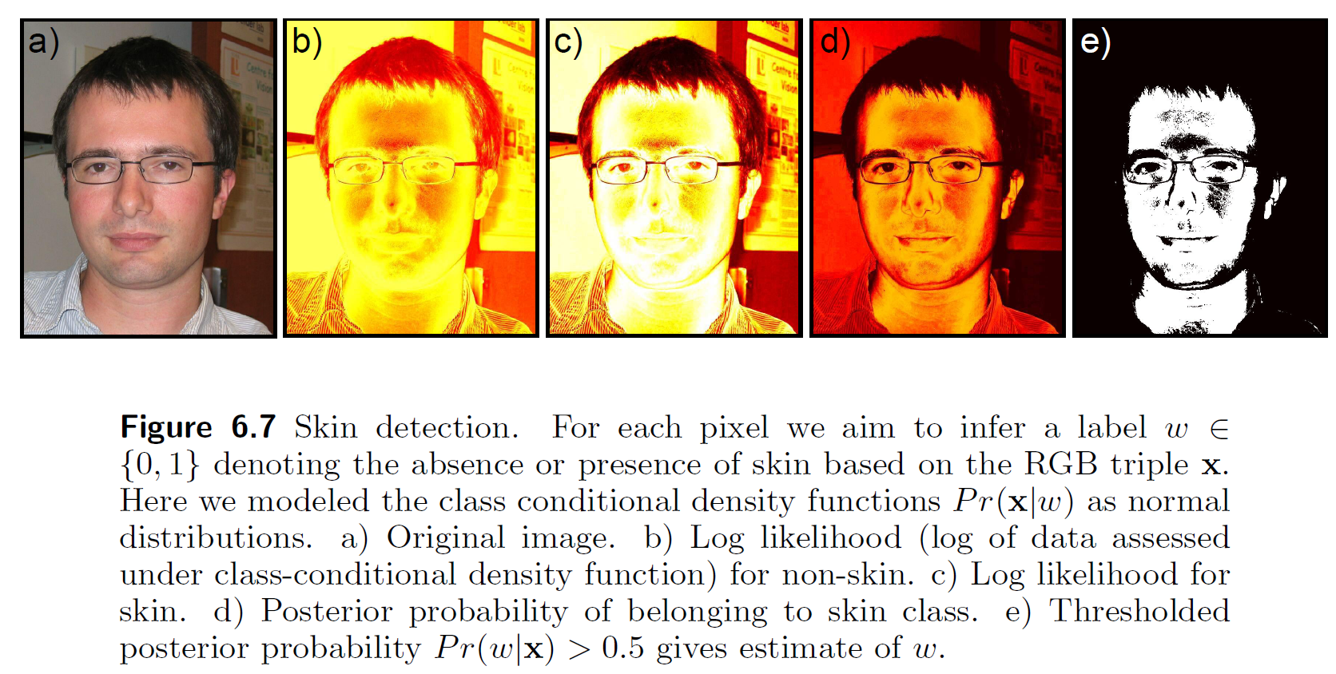
Application: Skin Detection
Computer vision: models, learning and inference. ©2011 Simon J.D. Prince
46

Slide 47
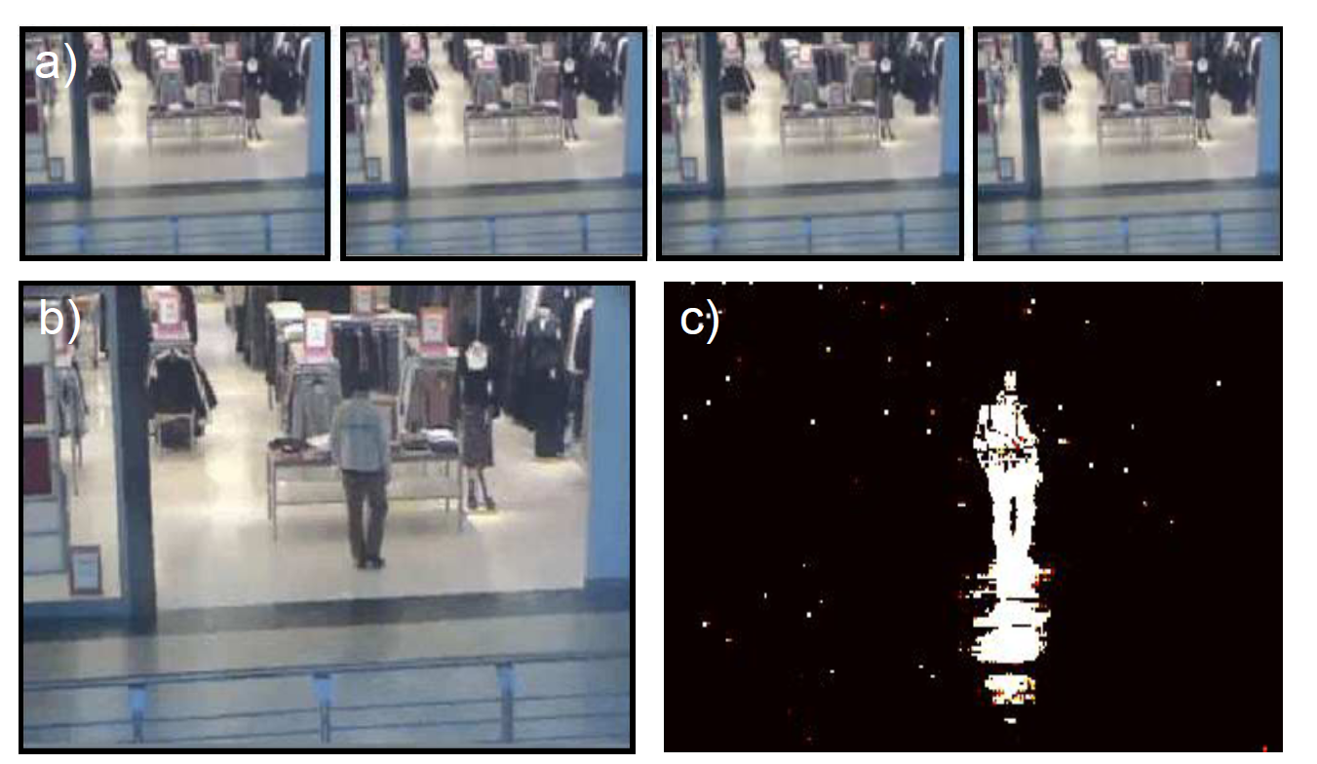
Application: Background subtraction
Computer vision: models, learning and inference. ©2011 Simon J.D. Prince
47

Slide 48
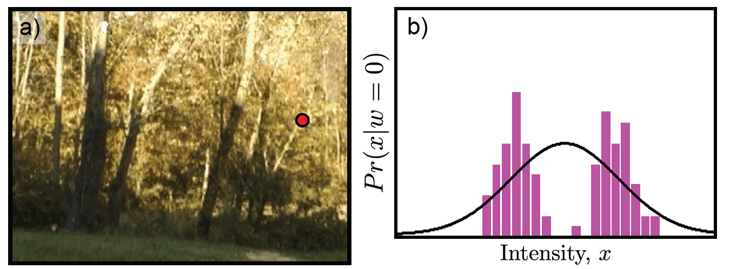
Application: Background subtraction
But consider this scene in which the foliage is blowing in the wind. A normal distribution is not good enough! Need a way to make more complex distributions
Computer vision: models, learning and inference. ©2011 Simon J.D. Prince
48

Slide 49
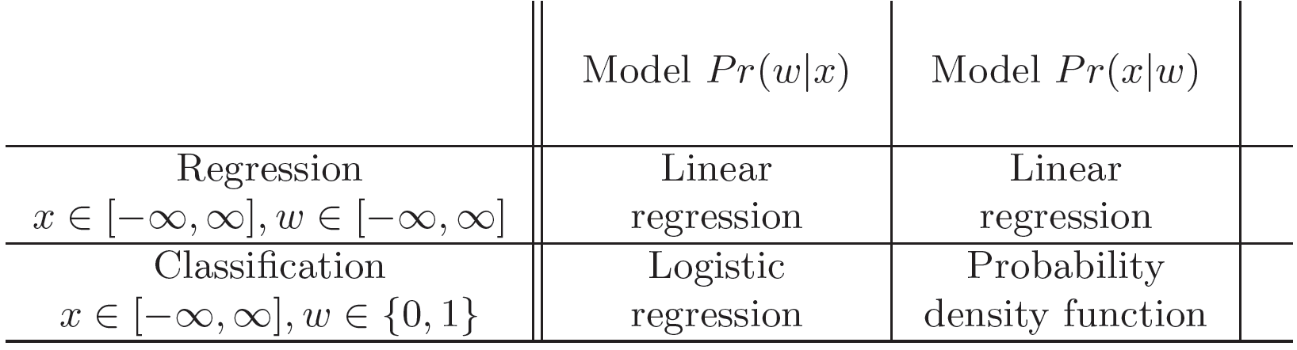
Future Plan
Seen two types of model
Probability density function
Linear regression
Logistic regression
Next three chapters concern these models
Computer vision: models, learning and inference. ©2011 Simon J.D. Prince
49

Slide 50
Conclusion
To do computer vision we build a model relating the image data x to the world state that we wish to estimate w
Three types of model
Model Pr(w|x) -- discriminative
Model Pr(w|x) – generative

